Slide 1
Two-Day Training for Serving Secretaries to Boards, Panels and Committees in the University of Lagos
Feyi Ademola-Adeoye
Institute of African & Diaspora Studies
University of Lagos

Slide 2
Communication in the Digital Age
Digital describes the technique of storing, transmitting and processing data; it involves transforming information of every kind, from text to sound to image, into sequences of numbers. Most electronic gadgets (watches, cameras, washing machines, computers, mobile phones, etc.) are now driven by digital technology. Developments in these technologies appear to be having a profound and potentially lasting impact on English, affecting both the forms of the language itself and the communicative practices in which its speakers engage. The term ‘digital English’ encompasses both the changing language and the emerging practices.

Slide 3
Some Concepts
Digital Talk: Is a form of language use which has characteristics of ‘talk’ and ‘text’. Talk in digital context does not necessarily refer to oral communication. Although it is possible to communicate orally online (through programmes like Skype, zoom, video calls, etc), most linguistic research on digital communication focuses on cases where textual media, such as email and online messaging, are used in a ‘speech-like’2way
Digital texts: These are texts that are stored in a digital medium rather than printed, written or engraved on a physical surface. The term ‘digital text’ is by contrast, used to describe more stable resources such as ebooks and individual blog postings

Slide 4
Despite the impact of digital technology on how people communicate, ultimately it is the people who use it who choose what they will do with it. Individuals can potentially exploit different technologies in different ways. For example, Short Message Service (SMS) may have appeared to be a constraining and unlikely medium of communication when it was added to mobile phones in the 1990s as a way for engineers to communicate. However, the people who took up the technology and used it for various social purposes (the start of text messaging as we know it!) saw and exploited possibilities that the phone manufacturers had underestimated.

Slide 5
Digital technology continues to change so fast that what you or I were doing in 2023 may not be what either of us will be doing by this time next year. Think about the digital technology you were using this time last year or 4 years ago, and how it differs from your current list. Online options are increasingly diverse (Messenger , for example now offers many of the same facilities as Skype; Facetime, WhatsApp Video Call ); There are numerous national and international social network sites (SNS); and often it is simply a question of what the people you want to communicate with are themselves using (Zoom, Microsoft teams)

Slide 6
Before we continue:
take a moment to reflect on the importance of digital technology to your communicative practices.
List the forms of digital communication you use (including phone calls, text messaging, internet, etc)
How often do you use them and what do you use them for?

Slide 7
Digital English
Computer-mediated communication is predominantly text-based human to-human interaction mediated by a network of computers or mobile telephony (Herring 2007). Hence, digital interaction has the following characteristics:
It is produced, disseminated and accessed through computers or mobile phones (which are in reality small computers). Digital communications is a product not only of computer technology, but also of communication and information technology by which it is disseminated –
Usually the internet, but also local computer networks or ‘intranets’. This may affect the, respectively, the size of the message that can be sent and the speed of the delivery.

Slide 8
It takes place between people (human-to-human), rather than between people and machines or machines and other machines. It is important to remember that people – as well as machines – shape digital communications.
It is largely text-based in the sense of being written rather spoken despite its name. Even online ‘chat’ involves short, typed messages rather than speech. At the same time, a characteristic feature of digital English is its multimodality. Digital communications technology provides genuinely new multimodal affordances, such as the possibility of embedding digital images, video and sound files in a web page.

Slide 9
Features of new/digital media
The mobile or smart phones allow users to communicate quickly
Whatsapp allows quick communication in real-time chatting
Technical restrictions of text messaging have led to the development of language short forms which save character, space as compared with using the full forms of words.
It is an inexpensive means of communication
It doesn’t always follow the standard rules of English grammar (Bush, 2005)
It is a private communication. This allows users to rebel against the standard rules of English language (Ong’onda, Matu and Oketch, 2010)
The character space limitation and cumbersome text input tends to make the terse and rude behavior acceptable among texters (Ling, 2003)

Slide 10
Creative use of abbreviations amongst interlocutors (Leake, 2008)
Use of fewer subordinate clauses and a narrower range of vocabulary
Use of slang, syntactic reductions, asterisks, emoting, emoticons.
Deletion of parts of speech, especially subject pronoun preposition, articles, copula, auxiliary or modal verbs and contractions.
Structural fragmentation which makes the language of digital media sometimes interactionally incoherent because of the limitations imposed by computer messaging systems on turn-taking (Herring 2001)
Language variation is patterned by age and region (Androutsopoulos, 2006)

Slide 11
Several rules of Standard English in the areas of punctuation, capitalization and spelling are not adhered to.
Rather than condemning it, we should embrace the fact that the internet is allowing us to explore the power of the written language in a creative way.
On the positive side, the internet aides documentation- recording of ethological material.
It also aids language revitalization by enabling speakers separated by space to maintain a virtual contact through email, chat, and instant messaging environments and there are some very lively interactions out there now.
On the negative side, the internet can be used to foster terrorism, fraud and pedophilia. This gives concerns for security and protection

Slide 12
General linguistic features of online communication
The list is in-exhaustive. However some of the most common features are presented below:
Shortenings (missing end letters), e.g “thanx” for “thanks”
Contractions (missing middle letters), e.g “gd” for “good”
‘g’ clipping (final letter missing), e.g “mornin” for “morning”
Other clippings, e.g “ve” for “have”
Acronyms and initialisms, e.g “v” for “very”
Letter/number homophones e.g “1” for one, “4eva” for “forever”, “b4’ for “before”, “ur gr8” for “you’re great”
Accent stylization (speaker tries to represent a particular pronunciation, for example regional speech), e.g “wivout” for “without”, “wassup” for “what’s up”
Non-alphabetic symbol

Slide 13
Emoticon such as ‘smilies’ and ‘winkies’ (Shortis 2001, Herring 2012)
Repeated punctuations e.g !!!!,?!, etc
Phonetically-motivated letter substitutions e.g “z’ for “s”
Eye dialect “sez” for “says’
Spellings that represent prosody or non-linguistic sounds such as a calling voice (helloooo), laughter and other (non-human) noises.
Outcome of word formation processes like clipping “nick” for “nickname”
Blending- “netizen” for network citizen
Acronyms- “lol” for “laugh out loud”, “Jk” for “just kidding”, “OMG” for “Oh my god”, “WTF” for “what the fuck”
Conversion – “text”, “whatsapp”, “spam” which are originally noun words can now be used as verbs

Slide 14
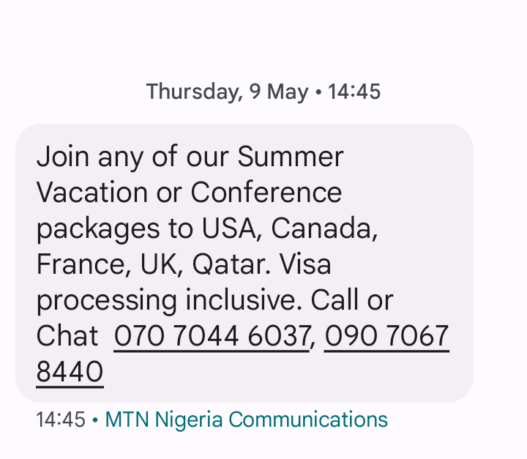
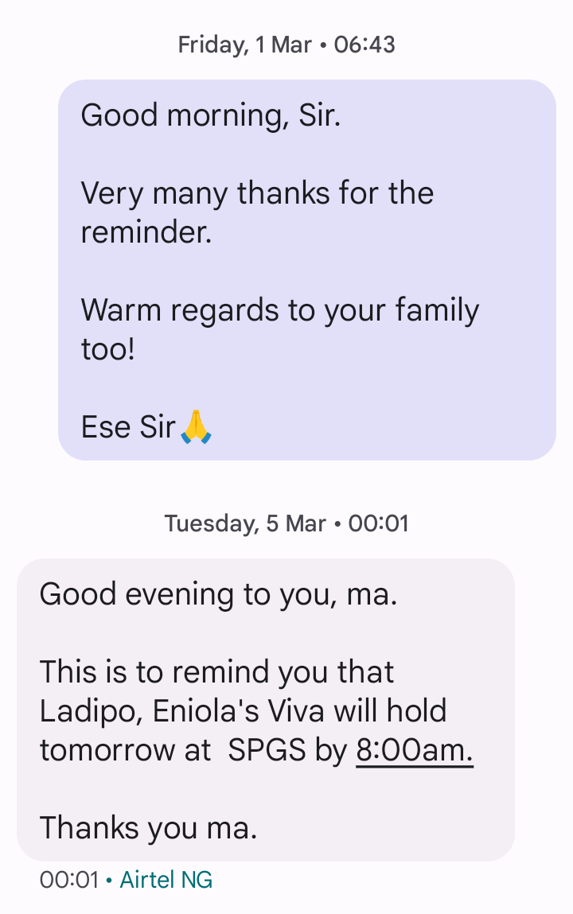
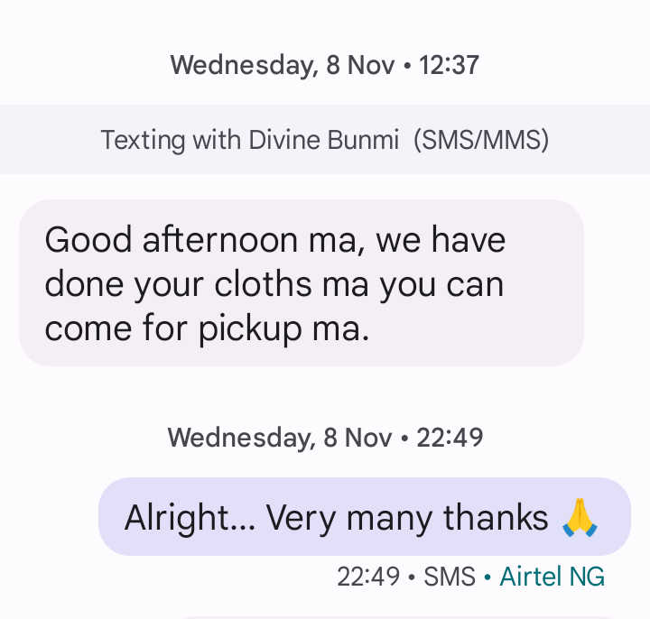

Slide 15
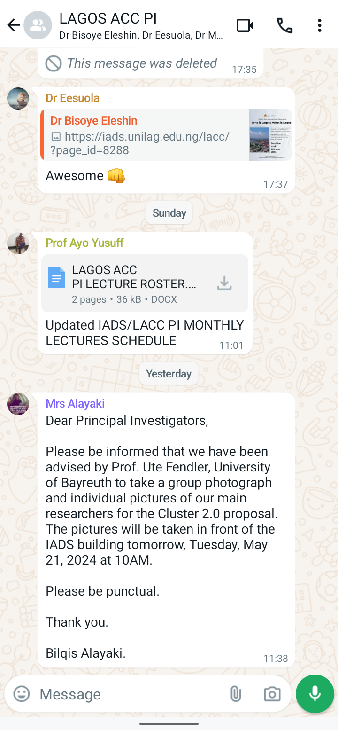
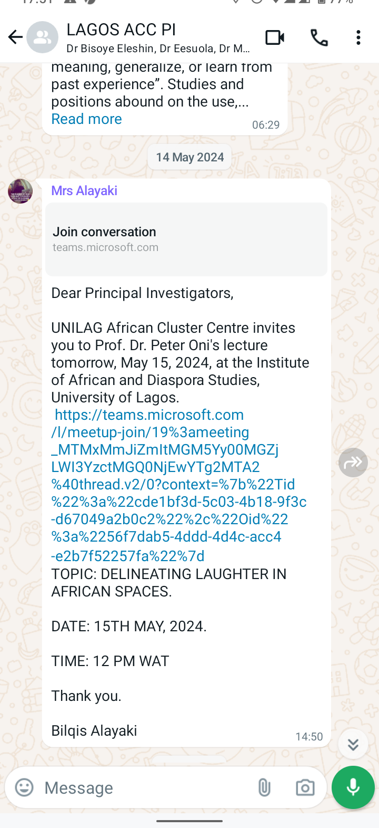
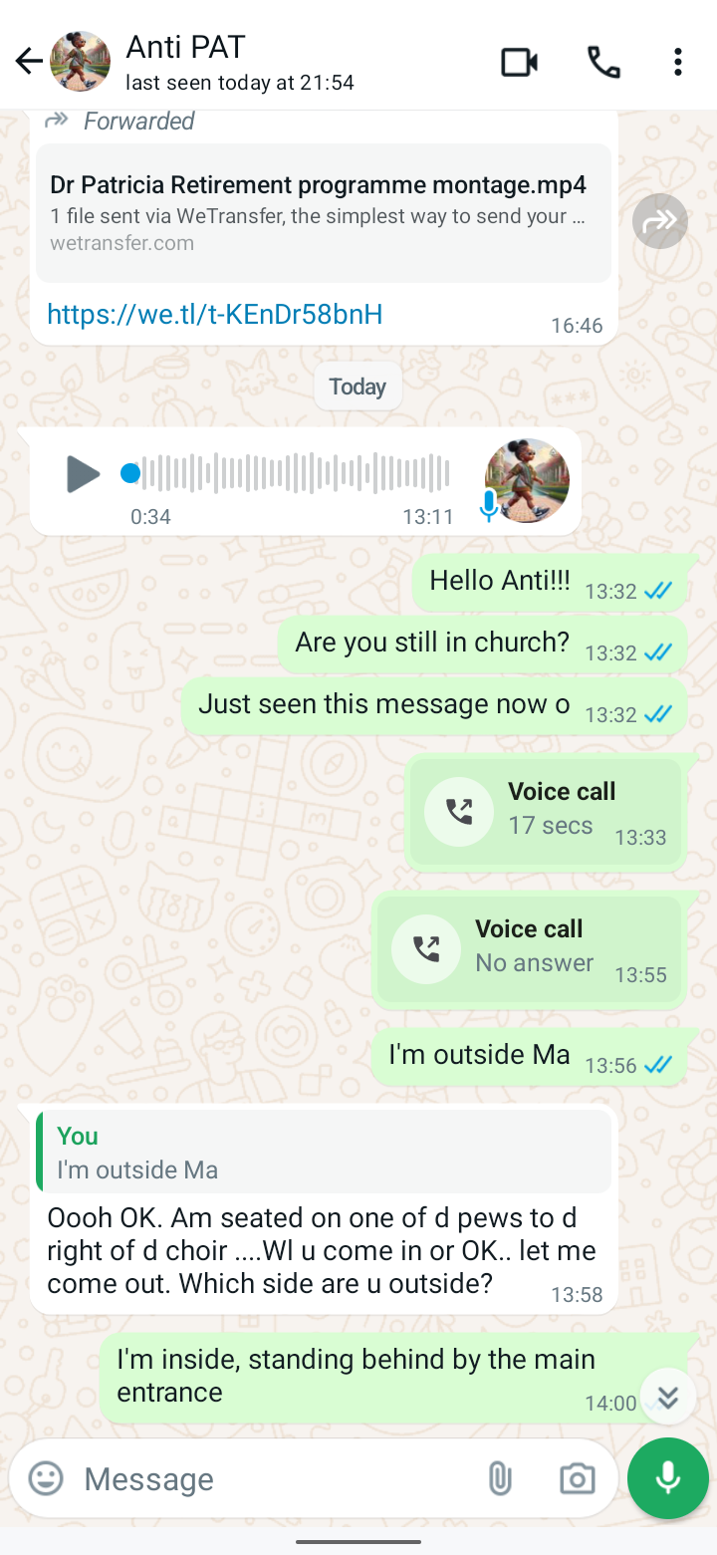

Slide 16
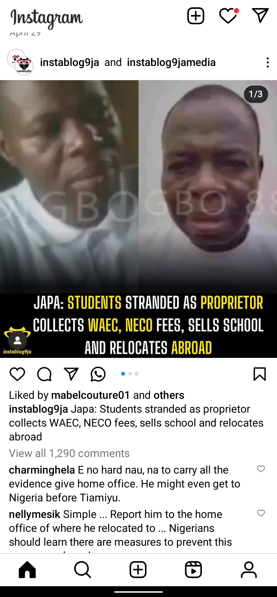
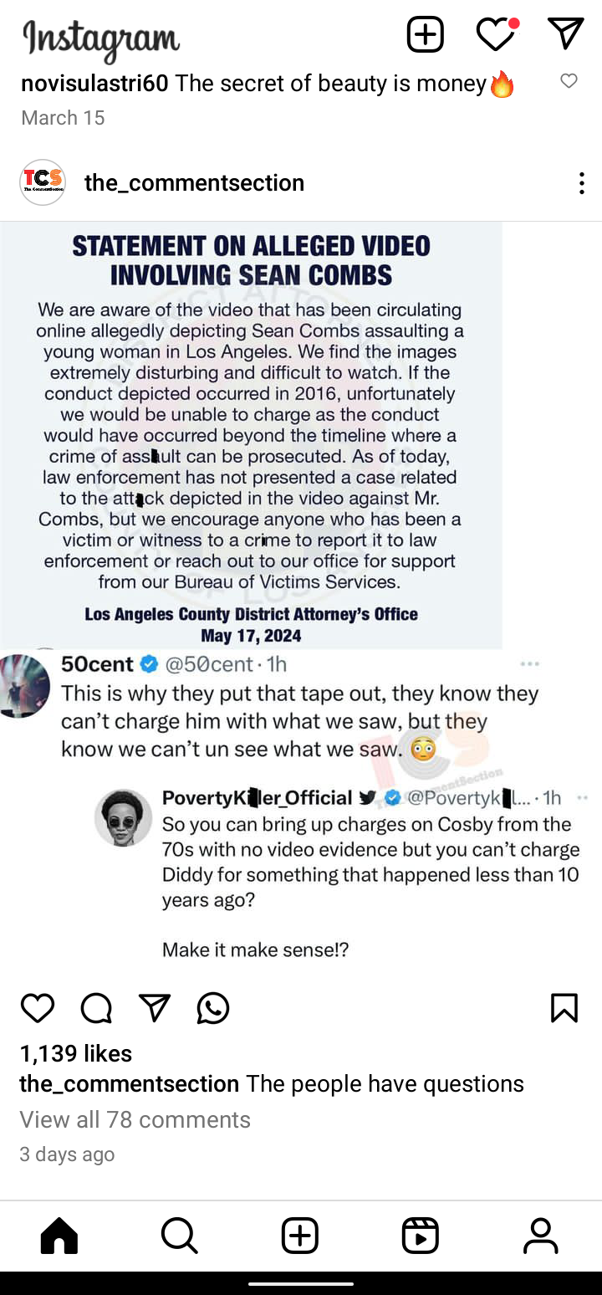
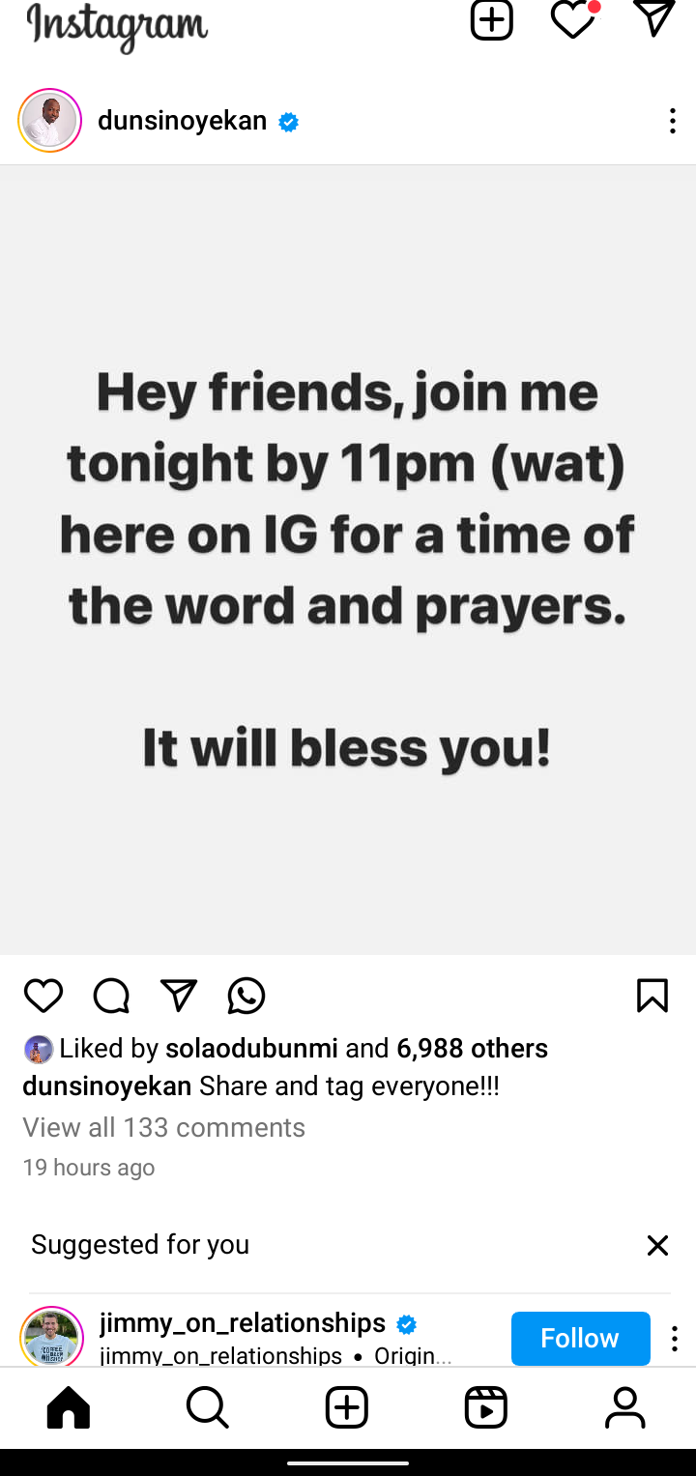

Slide 17
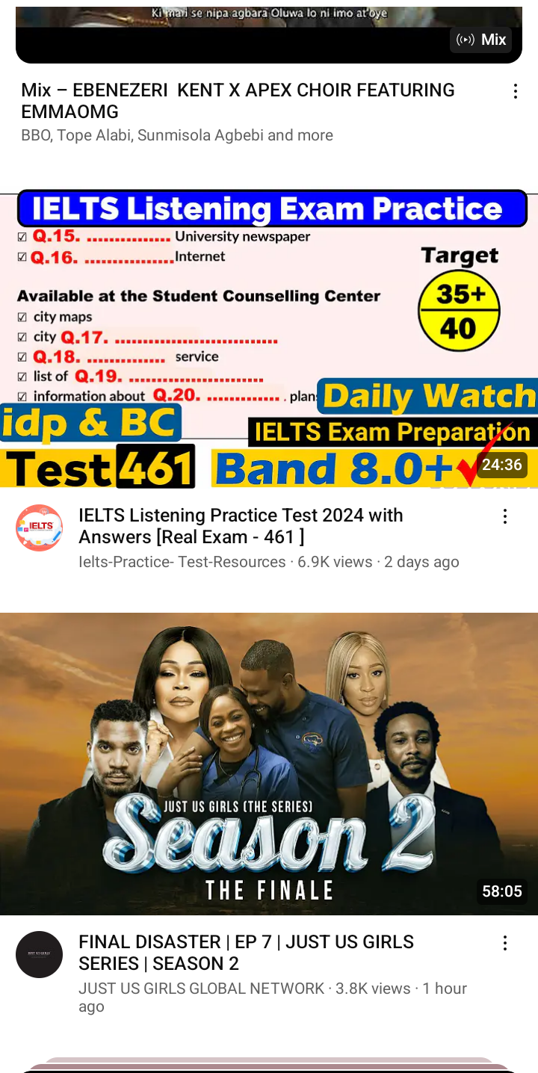

Slide 18
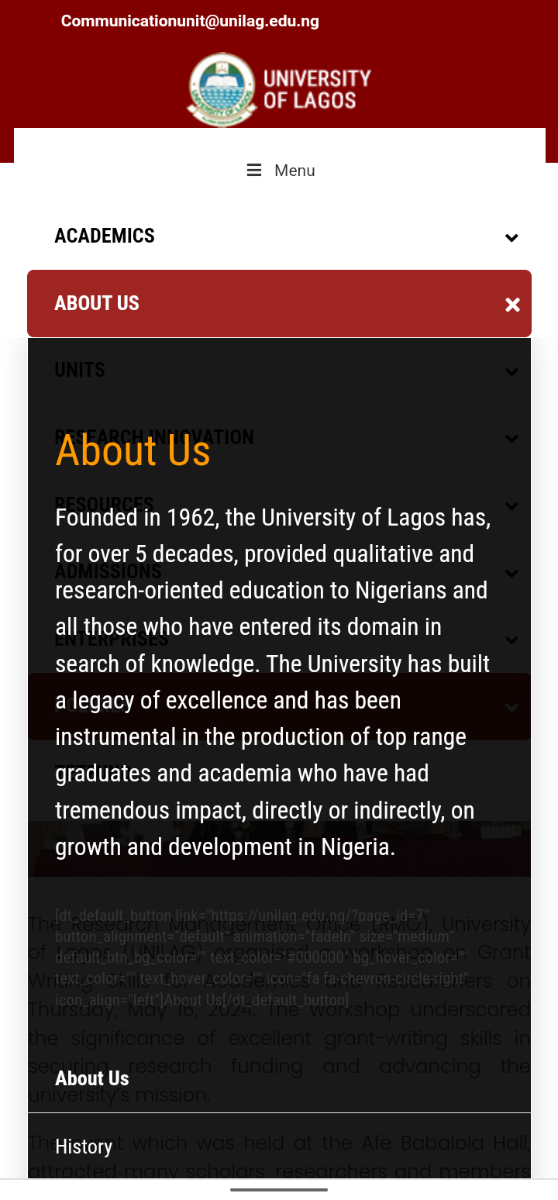
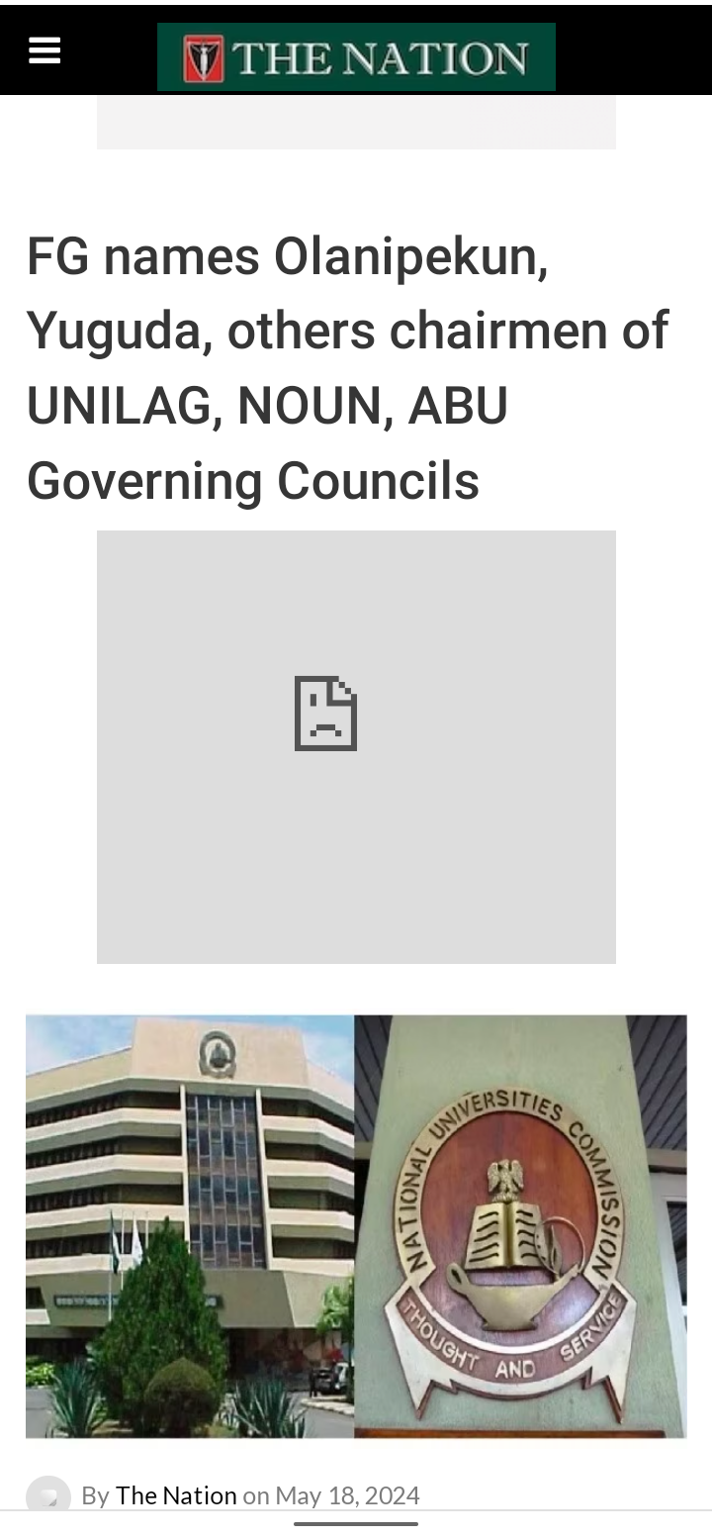
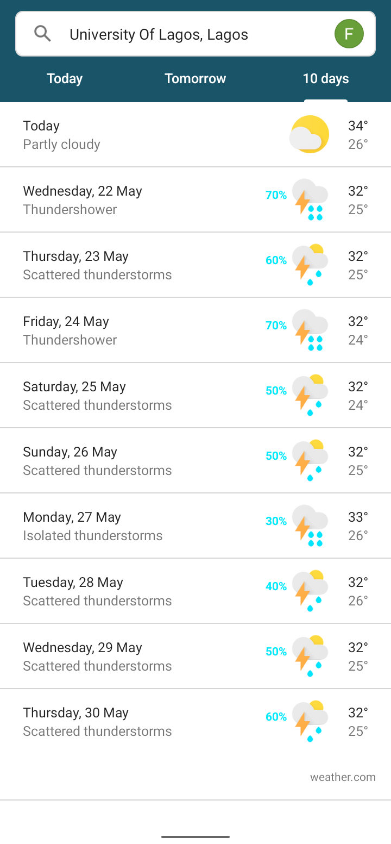

Slide 19
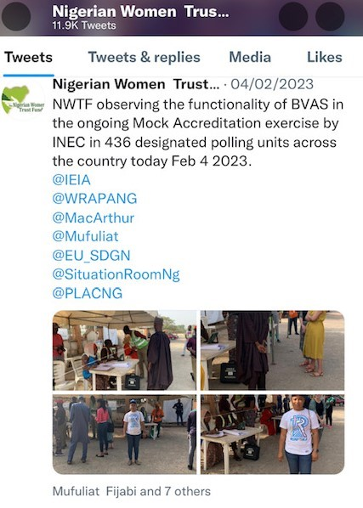
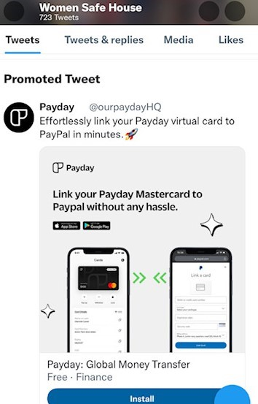
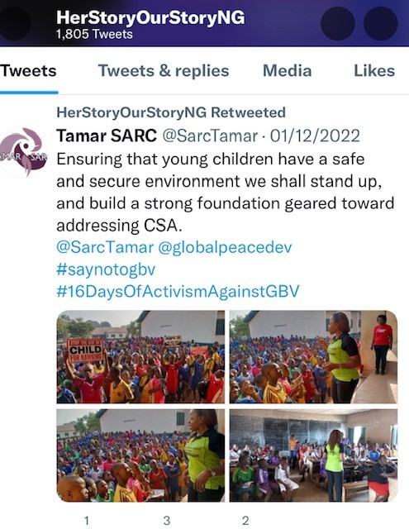

Slide 20
Thanks for your time

