Slide 1
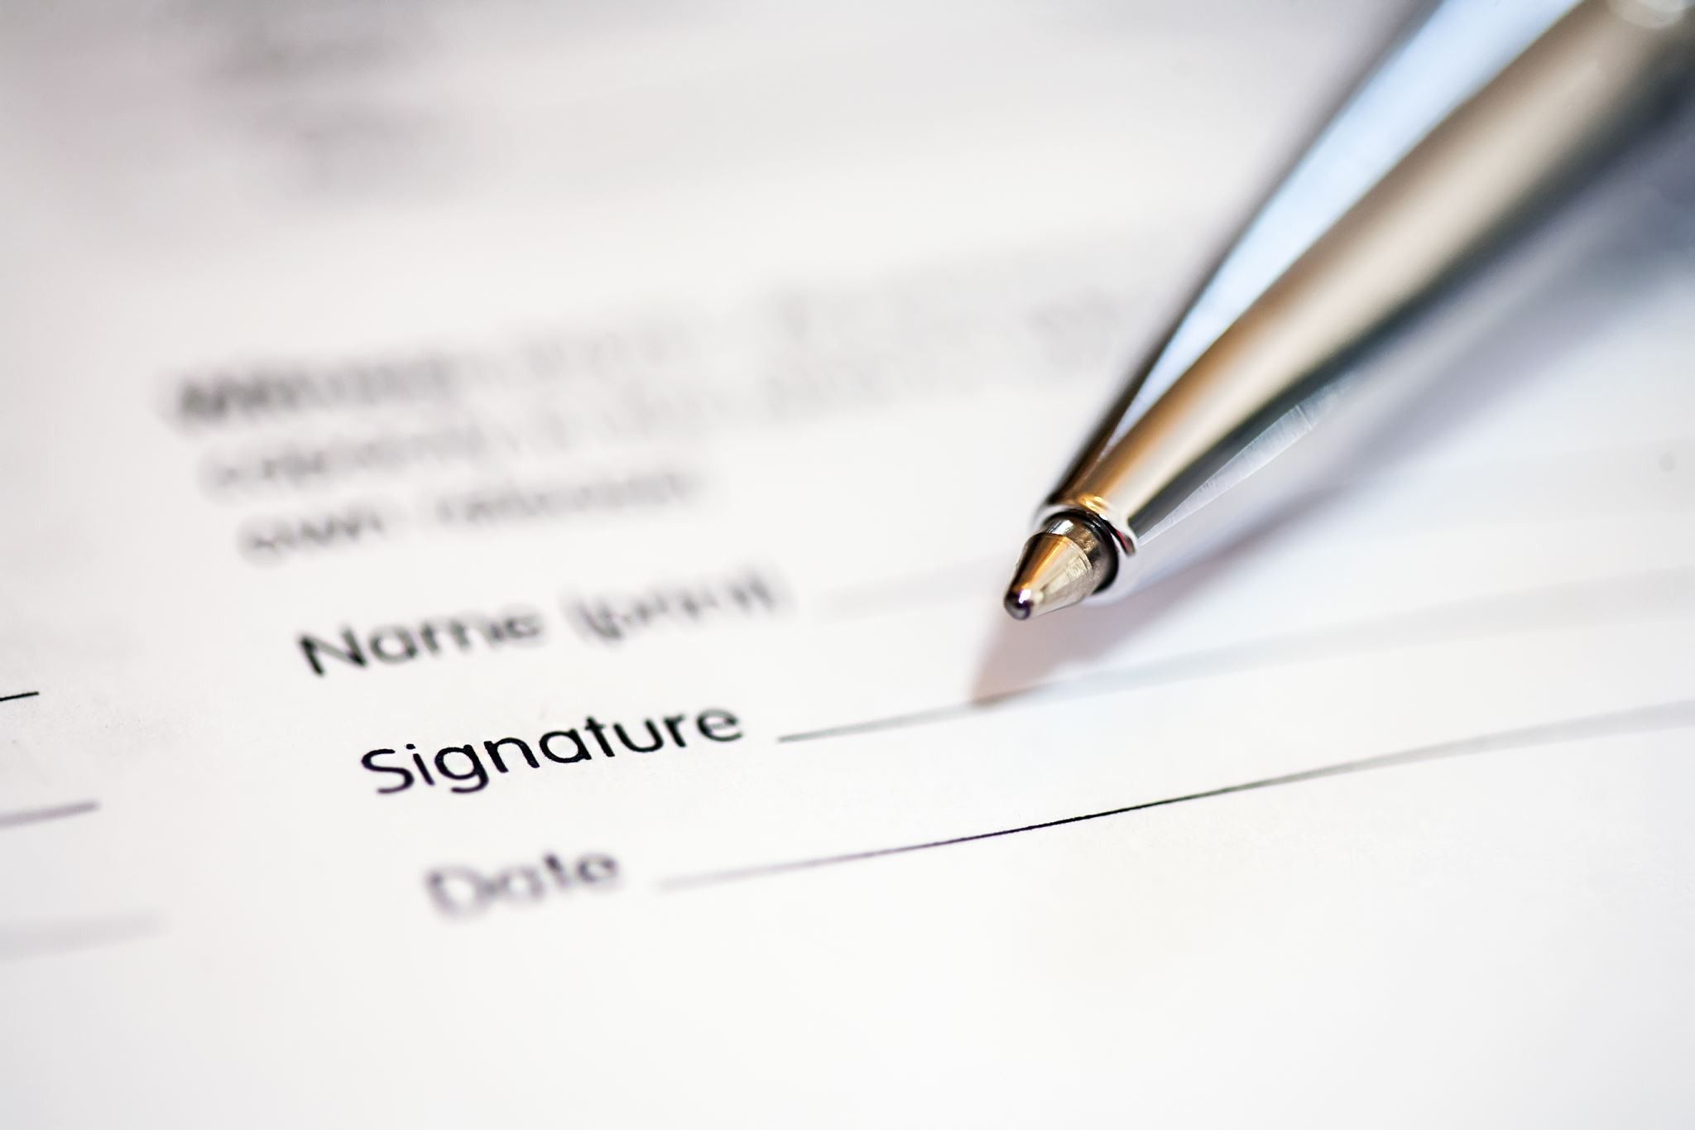
Processing of Undergraduate Results

Slide 2
Processing of Undergraduate Results
Each department is solely responsible for generating its students’ results on the Premier Platform.
Departments must hold meetings to consider broadsheets and summary sheets. Thereafter, the results are considered at the Faculty Board of Examiners’ meeting. As a rule, the University Examinations Officer or a representative must be present at such meetings to consider results.
The Examinations’ Officer will advise and guide the Board of Examiners on the results so presented.
The broadsheets considered by the Faculty Board of Examiners should then be submitted for online approval.
The broadsheet and summary sheet with the caption ‘submitted for approval’ would be printed, duly signed by the relevant signatories (original hard copies and twenty-five copies) forwarded to the Examinations’ office.

Slide 3
Upon receipt of the broadsheet, the Examinations’ Office would make a quick check on the result as follows:
Has the previous result been approved?
Has the broadsheet been signed by the relevant signatories?
Has the broadsheet been submitted for approval?
Have the results of students listed as incomplete (INR) in the previous broadsheet been completed before the present result?
Does the number of students in the previous approved broadsheet tally with the present results after taking into consideration all the factors that could lead to reduction or increase in the number of students of the same cohort?
If the broadsheet is an amended broadsheet, is the approval letter to amend the result attached to the broadsheet?
Is the broadsheet legible and meets the required 12 font size?

Slide 4
Broadsheets that do not meet any of the conditions listed above would be returned to the Department from the Examinations’ Office with a memo stating the observations. If the broadsheet satisfies the conditions enumerated above, it would be processed to the BCOS for consideration; the results are either recommended to the Senate for approval or returned to the department for corrections.
NB: Results for which hard copies have been submitted to the Examinations’ Office must not be rejected online without the knowledge of the Examinations’ office.

Slide 5
2. Attendance at the Faculty Board of Examiners’ Meetings
The Examinations’ Office on a regular basis attends the Faculty Board of Examiners meetings scheduled for the consideration of students’ results. This is to ensure that Faculties comply with Senate-approved guidelines on the presentation of results.

Slide 6
3. Online Approval of Results
As the Unit responsible for the online approval of the Senate-approved results, the Examinations’ Office does the online approval at the end of every Senate meeting. The online approval has implications for the generation of broadsheets for subsequent sessions and generations of the graduation list for the convocation ceremony.

Slide 7
4. Processing of Results for Vice Chancellor’s Signature
Senate-approved broadsheets are processed for the Vice Chancellor’s signature. The signed broadsheets are forwarded to the Departments, Faculty Offices, and University Records’ Office for record and processing of transcripts, statement of results, and NYSC mobilization.

Slide 8
5. Tracking of Results
The results submitted to the Examinations’ Office are tracked to ensure that there is no lacuna in the inventory of broadsheets received from departments, and processed to BCOS and Senate. There is a template wherein all the results are recorded to ensure seamless tracking of results presented so far and also to update the policymaker on issues related to results. At the end of every semester, departments with outstanding results are informed and requested to forward results for processing.

Slide 9
6. Amendment of Results
All previously Senate-approved results with any inherent error remain the official result of the department cum students listed therein. The concerned department could initiate the amendment of such results by strictly following the amendment procedure laid down by the Senate.
The Department requesting to amend students’ results would submit its’ request with other supporting documents to the Examinations Office. The Course Adviser and the Examiner for the course to be amended are invited to the BCOS meeting to defend their request. The BCOS makes a decision on the presentation and it could recommend the request to Senate for approval or otherwise. If BCOS is not satisfied that the request meets the guidelines set by the Senate, the Course Adviser or the representative of the department would be duly informed of the reason(s) for not recommending the request. Requests can either be recommended, not recommended, or stepped down. A stepped-down request could be represented, while the not recommended should not be represented. After the Senate meeting, the decision of the Senate on the request would be communicated to the concerned department and the Director (CITS) for further action.

Slide 10
7. Processing of Scheme of Examinations and Panel of Examiners
At the beginning of every session, a memo is sent to all Heads of Department for processing of the Scheme of Examinations and Panel of Examiners (Schemes) through the Business Committee of Senate (BCOS) for Senate approval. Departments are, via the memo, requested to submit original and twenty copies of the Scheme to the Examinations’ Office.
Upon receipt, the Schemes are vetted by the Examinations’ Office to ensure compliance with the approved guidelines. The scheme that meets the guideline is processed to BCOS for its consideration, while the Scheme with corrections is returned to the relevant department by the Examinations’ Office with a memo. After BCOS, incorrect Schemes are also returned to the department via a memo detailing the observations of the BCOS, while Schemes that are found to be in compliance with Senate guidelines are recommended to the Senate for approval.

Slide 11
The Schemes must meet the following requirements:
Each course must have a minimum of two Internal Examiners.
External Examiner from a State/Private Universities must be of Professorial status, while External Examiner from Federal Universities must be at least Senior Lecturer.
The name of the Chief Examiner/Head of Department should be asterisked where it appears on the Scheme.
There should be consistency in writing the names and status of Internal Examiners.
Assistant Lecturers are not to be listed in the Panel of Examiners.
The new course codes should be used where applicable. The Scheme must be duly signed by the relevant signatories.
The full postal, e-mail addresses and GSM phone numbers of External Examiners must be given.
The Scheme should follow approved format.

