Slide 1
PRESENTATION ON RED FLAGS IN STUDENTS WITH DRUG & MENTAL HEALTH ISSUES & REFERRAL TO THE COUNSELLING UNIT WEDNESDAY, 26TH –THURSDAY, 27TH OCTOBER, 2022 AT STAFF TRAINING AND DEVELOPMENT CENTRE, UNIVERSITY OF LAGOS

Slide 2
OUTLINE
Introduction
Definition of Mental Health
3. What is Mental Disorder
4. Types of Mental Disorder
5. Signs of good mental health
6. What mental health is not
7. Causes of mental health problems
8. Red flags in mental health
9. What to do
10. Location of Counselling Centres on Campus
11. Channels for on-line counselling
12. Meet the University Counsellors
13. Appreciation

Slide 3
INTRODUCTION
Mental health issues is a global challenge. The rate at which undergraduate students become mentally challenged is alarming.
In various higher institutions, students are faced with lots of challenges such as financial difficulty, accommodation problem, poor interpersonal relationships, Sexual Harassment/assault etc. and these challenges affect their mental well-being.
Often, reports of incidences of outburst owing to mental challenges were brought to the attention of the Counselling Unit for intervention.

Slide 4
DEFINITION
Mental health refers to cognitive, behavioral, and emotional well-being. It is all about how people think, feel, and behave. It means when you are in a sound state of mind, your emotions and actions will be positive or beneficial.

Slide 5
WHAT IS MENTAL HEALTH DISORDER
Is a wide range of conditions that affect mood, thinking and behaviour.
TYPES OF MENTAL HEALTH DISORDER
Anxiety Disorder - People with these conditions have severe fear related to certain objects or situations. They always try to avoid exposure to whatever triggers their anxiety.
Panic Disorder - People with a panic disorder experience regular panic attacks involving sudden, overwhelming terror or a sense of imminent disaster and death.
Phobias - fear of specific objects, scenarios, or animals. A fear of spiders is a typical example.
Obsessive Compulsive Disorder (OCD) - have obsessions and compulsions., they experience constant, stressful thoughts and a powerful urge to perform repetitive acts, such as hand washing etc.

Slide 6
TYPES OF MENTAL HEALTH DISORDER –CONTD…
Post Traumatic Stress Disorder (PTSD) - can occur after a person experiences or witnesses an intensely stressful or traumatic event. During this type of event, the person thinks that their life or other people’s lives are in danger. They may feel afraid or that they have no control over what is happening.

Slide 7
TYPES OF MENTAL HEALTH DISORDER –CONTD...
Mood disorders or affective disorders or depressive disorders - People with these conditions have significant mood changes, generally involving either mania, a period of high energy and joy, or depression. Examples of mood disorders include:

Slide 8
TYPES OF MENTAL HEALTH DISORDER –CONTD…
Major Disorder: Loses interest in activities and events that they previously enjoyed.
Bipolar Disorder: Unusual changes in trusted sources, in their mood, energy levels, levels of activity, and ability to continue with daily life.

Slide 9
TYPES OF MENTAL HEALTH DISORDER –CONTD…
Seasonal Affective Disorder (SAD): Change in behavioral patterns during each seasons of the year. For example during the raining season and dry season.
Schizophrenia Disorder: Having delusions, thought disorders, and hallucinations- hearing, seeing and imagine thing differently from others.

Slide 10
SIGNS OF GOOD MENTAL HEALTH
Be confident
Be optimistic
High self-Esteem
Goal-Getter
Feeling good about yourself
Self–Determination
Always happy
Friendly

Slide 11
CAUSES OF MENTAL HEALTH PROBLEMS
childhood abuse, dysfunctional home, sexual harassment/assault, trauma, or neglect.
social isolation or loneliness.
experiencing discrimination and stigma, including racism.
social disadvantage, poverty or debt.
bereavement (losing someone close to you)
severe or long-term stress.
having a long-term physical health condition.
Poor academic performance

Slide 12
RED FLAGS IN MENTAL HEALTH DISORDER
Loss of appetite
Self harm
Weight changes
Withdrawal/isolating oneself from others
Feeling helpless or hopeless
Feeling agitated, restless or violent

Slide 13
RED FLAGS IN MENTAL HEALTH CONTD…
Hypersomnia/Excessive daytime sleepiness
Sleeplessness/Insomnia
Unexpected or dramatic decline in academic performance
Excessive worrying/ fear
Extreme confused thinking
Delusions or hallucinations

Slide 14
RED FLAGS IN MENTAL HEALTH CONTD…
Substance abuse (alcohol or drugs, including prescription drugs
Suicidal Ideation
Multiple physical ailments without obvious causes (headaches, stomach aches, etc.)
Hyperactive behavior or routine lethargy
Abandonment or loss of interest in favorite pastimes or activities
Excessive eating or Loss of appetite
Trivialization/ Procrastination

Slide 15
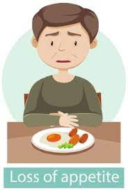
LOSS OF APPETITE

Slide 16
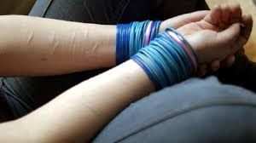
SELF-HARM

Slide 17
WEIGHT CHANGES

Slide 18
WITHDRAWAL/ISOLATING ONESELF FROM OTHERS

Slide 19
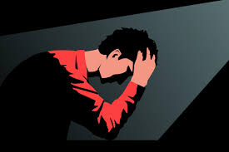
FEELING HELPLESS OR HOPELESS

Slide 20
FEELING AGITATED, RESTLESS OR VIOLENT & FRUSTRATED

Slide 21
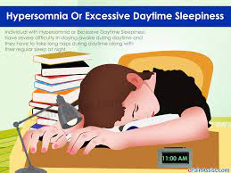
HYPERSOMNIA/EXCESSIVE DAYTIME SLEEPINESS

Slide 22
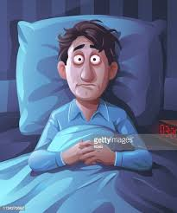
SLEEPLESSNESS/INSOMNIA

Slide 23
UNEXPECTED OR DRAMATIC DECLINE IN ACADEMIC PERFORMANCE

Slide 24
EXCESSIVE WORRYING/ FEAR

Slide 25
EXTREME CONFUSED THINKING

Slide 26
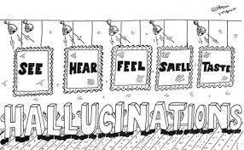
DELUSIONS OR HALLUCINATIONS

Slide 27
SUBSTANCE ABUSE (ALCOHOL OR DRUGS, INCLUDING PRESCRIPTION DRUGS)

Slide 28
IDEAS OF SUICIDE

Slide 29
MULTIPLE PHYSICAL AILMENTS WITHOUT OBVIOUS CAUSES (HEADACHES, STOMACH ACHES, ETC.)

Slide 30
HYPERACTIVE BEHAVIOR

Slide 31
ABANDONMENT OR LOSS OF INTEREST IN ACADEMICS & FAVORITE PASTIMES/ACTIVITIES

Slide 32
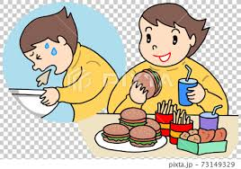
EXCESSIVE EATING

Slide 33
WHAT TO DO CONSULT THE COUNSELLOR, A MEDICAL DOCTOR OR A CLINICAL PSYCHOLOGIST

Slide 34
LOCATION OF COUNSELLING CENTRES ON UNILAG CAMPUS

Slide 35
S/N | COUNSELLING CENTRES | COUNSULTING DAYS | TIME
1 | Faculty of Education Counselling Clinic beside the HOD’s Office, Educational Foundations | Tuesdays, Wednesdays & Thursdays | 10:00 a.m.-12:00 noon & 2:00 p.m. -4:00 p.m.
2 | Chapel of Christ Our Light (Protestant) University of Lagos, Akoka, Lagos (UPPER ROOM) | Tuesdays, Wednesdays & Thursdays | 10:00 a.m. -12:00 noon & 2:00p.m to 4:00p.m.
3 | St. Thomas More Catholic Chaplaincy, University of Lagos, Akoka, Lagos | Tuesdays, Wednesdays & Thursdays | 10:00 a.m. -12:00 noon & 2:00p.m. to 4:00p.m.
4 | Counselling Clinic, Medical Centre, University of Lagos (FOR STAFF ONLY) | Tuesdays, Wednesdays & Thursdays | 10:00 a.m. -12:00 noon & 2:00p.m. to 4:00p.m.
5 | UNILAG Counselling Centre, First Floor, Bookshop Building, Akoka, Lagos | Mondays – Fridays | 8:00 a.m. – 5:00 p.m.
6 | Counselling Unit, CMUL, Idi-Araba, Mushin, Lagos | Mondays -Fridays | 8:00 a.m. – 5:00 p.m.
7 | UNILAG Mosque (Block 4 Room 2) | Tuesdays, Wednesdays & Thursdays | 10:00 a.m.-12:00 noon & 2:00p.m to 4:00p.m.

Slide 36
CHANNELS FOR ON-LINE COUNSELLING
S/N | CHANNEL OF COMMUNICATION | CONTACT
1 | Phone call & whatsapp | 0811-378-6226 & 0901-669-6232
2 | Email addresses | counselling@unilag.edu.ng or unilagcounsellor@yahoo.com or unilagcounselling@gmail.com
3 | Twitter | @unilagcounsel
4 | Facebook accounts | Counsellor Helper & Unilag Counsellor II
5 | UNILAG COUNSELLOR | Follow/like our facebook page
6 | Counselling Outreach on Radio Unilag every Friday from 3:30 p.m. to 4:00p.m. | Radio Unilag – 103.1FM
7 | Counselling Unit website | counselling.unilag.edu.ng

Slide 37
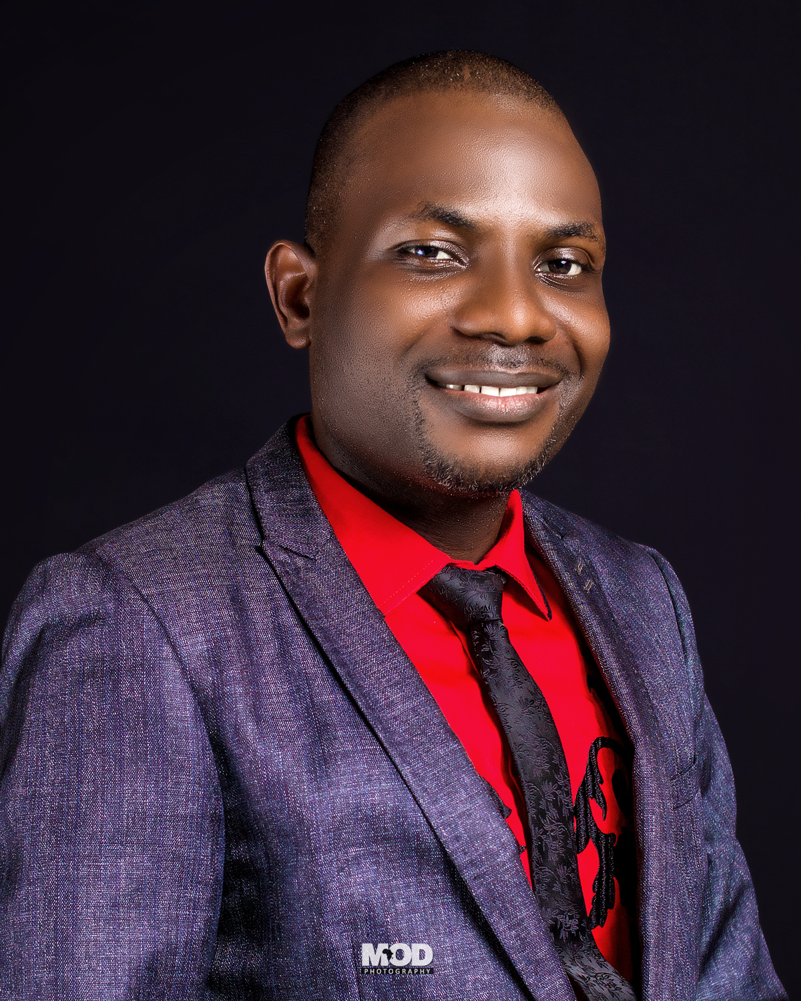
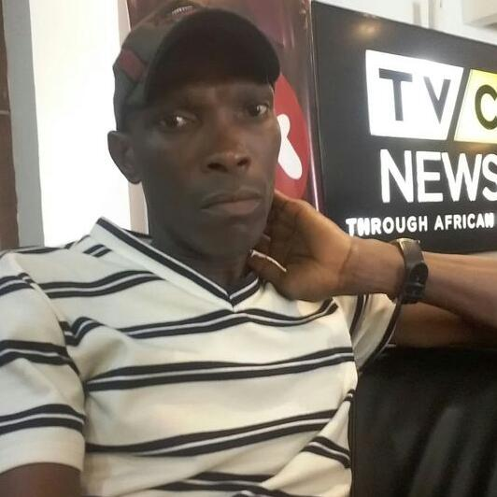
MEET THE UNILAG COUNSELLORS
JANET OLUWATOYIN AREGBESOLA
PRINCIPAL ASSISTANT REGISTRAR (COUNSELLING)
OLAYINKA AYINDE OMOTOLA
SENIOR ASSISTANT REGISTRAR (COUNSELLING)
IMOLE WITNESS AGBOJULE ADMIN. OFFICER II (COUNSELLING)
VICTOR ALIGHODA
HIGHER EXECUTIVE OFFICER & SOCIAL WORKER (COUNSELLING)

