Slide 1

University of Lagos
Staff Training and Development Unit
2-Day Capacity Building Workshop for Hospitality Officers and Porters
Presentation by
Dr. (Mrs.) Taiwo Folasade Ipaye, FNIM
Director, Arthur Mbanefo Digital Research Centre
University of Lagos
26th - 27th October, 2022.

Slide 2
Integrity and Credibility at Work & Sanctions to Deviants
27th October 2022

Slide 3


Protocol
2

Slide 4

Need for a Training
Why This Topic?
The University Stakeholders;
Staff:
Academic/Non - Teaching
Senior/Junior
Ad-hoc/ temporary
Students:
Undergraduate/Postgraduate
Full Time/Non FTE DLI/ foundation
Business Community:
Vendors, Artisans, Traders etc
Parents, Guardians, Regulatory agencies
3

Slide 5
Our Roles
Hospitality Officers
Serve as facility managers for the hostel
Have supervisory role over all other personnel in the halls
Responsible for the record keeping and inventory of items in the hall
Responsible for the peace , and harmony in the halls
First point of call for all grieviance and counselling issues
Ensure proper maintenance and repairs of all facilities in the hall
Actively involved in room allocation and occupancy
Porters
In charge of access to offices, rooms and halls by keeping custody of keys and luggage.
Maintaintenance of law and order in the hostels.
Maintenance of clean and secure environment.
Assist with moving heavy items and ensuring civility within the premises.
Also doubles as safety officers
4

Slide 6

What do we mean by Integrity and Credibility
Integrity
‘The quality of being honest and having strong moral principles that you refuse to change(Cambridge)
‘The quality of being honest and strong about what you believe to be right personal/professional/political etc. (Longman)
In general, integrity is a word used to describe a person's commitment to honesty and a willingness to do what's right. For example, a person who abstains from cheating, lying, or stealing would be considered to be a person who acts with great integrity.
5

Slide 7

What do we mean by Integrity and credibility Cont’d
Credibility
Qualities that someone has that make people believe or trust them (Macmillan)
The quality of deserving to be believed or trusted (Longman).
6

Slide 8

Importance of credibility and Integrity
What Integrity means
Having integrity means that you live in accordance to your deepest values, you're honest with everyone, and you always keep your word. Integrity is a highly valued trait, especially in leaders. When you live with integrity, you're more likely to be considered for important promotions and leadership positions.
7

Slide 9

Importance of credibility and Integrity Cont’d
Meaning of credibility
The quality of being believed or accepted as true, real, or honest
8

Slide 10

Building your Capacity
Examples of Integrity
Keeping promises...
Keeping secrets...
Not letting someone else take the blame...
Not gossiping...
Doing the right thing without expecting a reward...
Paying your taxes...
Being polite even when someone is rude to you...
Telling the truth…
9

Slide 11

Building your Capacity Cont’d
How to establish/ show credibility
Stay up to date with changes in your field...
Be transparent with information...
Value respect over likeability...
Grow professionally...
Encourage professional development in others...
Make well-advised and researched decisions...
Encourage teamwork and collaboration…
10

Slide 12

Building Your Capacity Cont’d
Showing integrity in the work place
Put in the hours. ...
Deal with conflict properly. ...
Report unethical behaviour. ...
Be upfront about your shortcomings. ...
Be willing to do hard work. ...
Take accountability for your actions. ...
Be a team player. ...
Respect others.
11

Slide 13

Building Your Capacity Cont’d
Gaining Credibility
Credibility is the quality of gaining legitimate trust, integrity, and dependability—a trait every leader should possess in the workplace. To establish credibility, you must be a trusted source of information and decision-making among your team members. But actions speak louder than words when demonstrating credibility.
12

Slide 14

Case Reviews
Based on her track records Mrs. lagbaja was deployed to Lagoon Front Hostel as the Hospitality Officer in 2017. Upon assumption of office, she noted that there were a number of administrative lapses especially with the record keeping and she set about putting things in order. However, the Officer who handed over to her sat her down, and explained various opportunities available for making extra money including non declaration of bed spaces and allocating such under the radar. She further requested to be allowed to continue to bring customers for such transactions
If you were Mrs Lagbaja, how will you handle the situation
13

Slide 15

Case Reviews Cont’d
Mr. Foolnoone was employed as a Porter in 2010 and posted to the academic buildings where he served for almost 10 years. Upon his promotion to supervisory cadre, he was moved to the Hostel as a supervisor. However Mr. F had gotten used to absenteeism and being covered up by colleagues in his earlier postings, a habit which he found difficult to get out of. Most of his colleagues had also undergone additional training through personal self development and were now at least one grade above him whereas he had failed to add anything to his school certificate. He was also unable to make use of a computer for his administrative tasks and had to rely on one of the new recruits to carry out his supervisory role. Many of the junior colleagues found it easy teasing him and rarely carried out his instructions.
What are the challenges facing Mr F and how should he correct them?
14

Slide 16

Ensuring your Integrity and Credibility
Follow laid down rules and regulations.
Ensure you maintain proper records and inventory which are easily retrievable.
Ensure you effectively monitor activities in the hall in line with university policies.
Ensure you foster team ethics with other members of staff.
Avoid engaging in unwholesome verbal exchange with staff and students
15

Slide 17

Deviant Behaviours (Misconduct) Cont’d
A deviant behaviour is something or someone whose behaviour deviates from the rules and regulations or falls short of acceptable standards. In public service they come under acts of misconduct and carry a wide range of sanctions.
17

Slide 18
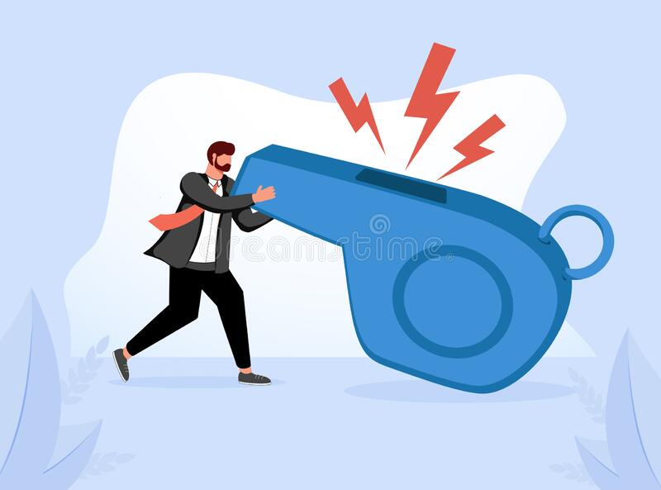
Deviant Behaviours (Misconduct)
Misconduct means any act or behaviour in or outside the university which is prejudicial to the good name of the university and or of discipline and proper administration, examples include but are not limited to;
Membership of secret cults
Instigating unrests or disorderly assembly
Stealing, forgery, extortion or illegal collection of money from students
Falsification of records
Sexual exploitation of students
Admission and examination malpractice
Drunkenness, insubordination, divided loyalty, negligence etc (See Yellow book)
16

Slide 19
Misconduct: This is a specific act of wrong doing or improper behaviour which can be investigated and proved. It can lead to termination ment. Examples of such include;
Scandalous acts such as; mImoral behaviour, Unruly behaviour, drunkennes, assault, Foul language etc
habitual lateness to work.
deliberate delay in treating official documents.
Failure to keep records
Dishonesty, negligence, sleeping on duty.
Improper dressing while on duty,
Hawking merchandise within office premises
Discourteous behaviour to the public
Insurbodinatiom
Gross Misconduct: is a specific act of serious wrongdoing and improper behaviour which can be investigated and if proven,ay lead to dismissal. e.g.
Falsification/suppression of records
Witholding of files
Conviction on a criminal charge
Absence from duty without leave
False claims against government officials
Engaging in partisan politics
Bankruptcy/ serious financial embarrassment
Bribery, corruption/embezzlement
Holding more than one full time job
Sabotage
Nepotism or any other form of preferential treatment
Notes:
ecific act of serious wrongdoing

Slide 20

Sanctions for acts of misconduct in the university
Misconduct
Verbal query
Written Query
Formal Warning
Witholding or deferment of annual increment
Reduction in rank
Termination of Appointment
Escalate to administrative panel if need be
18

Slide 21

Sanctions for acts of misconduct in the university Cont’d
Gross Misconduct
Suspension/interdiction
Disciplinary Panel
Determination of appointment
Dismissal from Office
(Sometimes legal redress follows)
19

Slide 22
Any Questions?

Slide 23



